Slide 1

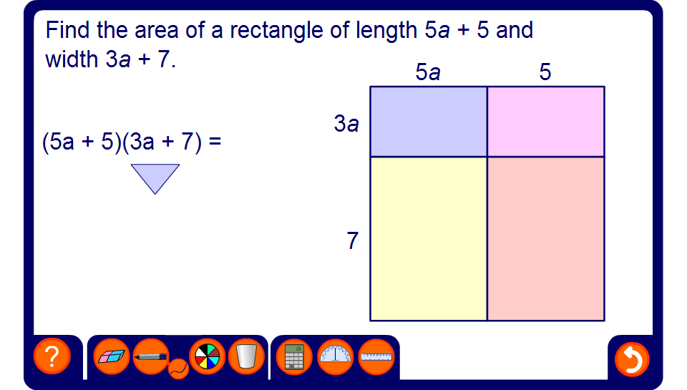


Find the area of the rectangle

